Slide 1
PHOENIX MUSIC PLAYER
ANDROID LAB LA COMPONENT
SUBMITTED BY, SUBMITTED TO,
MOHAMED RAYAN KHAZI 1NT18CS098 SUPRIYA C
SAKSHI THAKUR 1NT18CS141
SHROOTHI SINGH 1NT18CS156

Slide 2
ABSTRACT
Music is one of the best ways to relieve pressure in stressful modern society life. The purpose of this project is to develop a player which can play the mainstream file format. In order to solve the problem of complex functions of mobile phone music player on the current market, a new music player of simple, convenient, less required memory as well as user-friendly is developed. Based on the Android technology, using the Java language and Android Studio programming tools lead to design and coding of music player. The new design mainly realizes six core functions including main play interface, playlists, menus, play settings, favourites and song search.

Slide 3
INTRODUCTION
What is Android?
Open source and Linux-based OS for mobile devices such as smart phones and tablet computers.
Developed by the Open Handset Alliance
Why Android?
• Offers a unified approach to application development
• Variety of Applications
• Reliability & Reusability
• Multitasking
• Modifiability
• Portability

Slide 4
Music player in this project is application software based on Google Android. Music is one of the best ways to relieve pressure in stressful modern society life. The purpose of this project is to develop a player which can play the mainstream file format. To browse and query the storage space as well as operation of playing can be realized. Meanwhile, this software can play, pause and select songs with latest button and next button according to sets requirement as well as set up songs.

Slide 5
OBJECTIVES
The objective of this thesis is to propose development of android that:
1. Make it with a simple feature and run smoothly
2. Support gesture control
3. Support quick search
4. Support favouriting

Slide 6
EXTERNAL INTERFACE REQUIREMENTS
User Interface Tested on:
❑ Android emulator version 4.3
Hardware Requirement:
❑ Core i3 processor
❑ 4 GB RAM
❑ 500 GB Hard Disk
Software Requirement:
❑ Android SDK Manager
❑ Android Studio
❑ ADT(Android Development Tool)

Slide 7
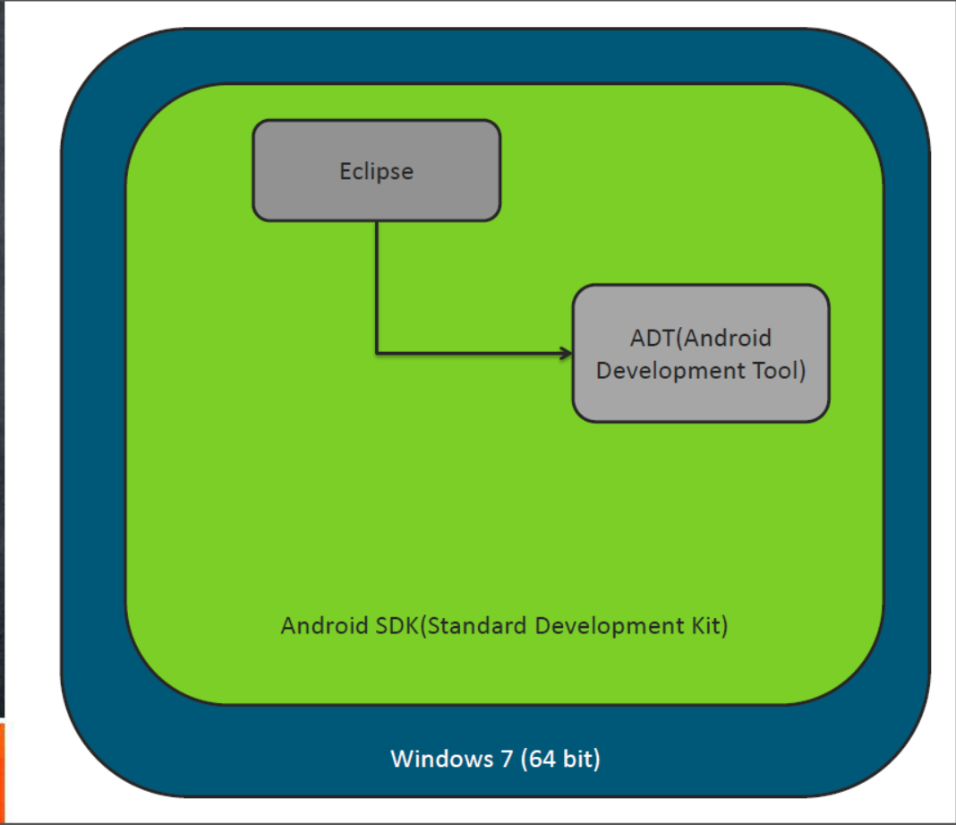
DESIGN
Android
studio

Slide 8
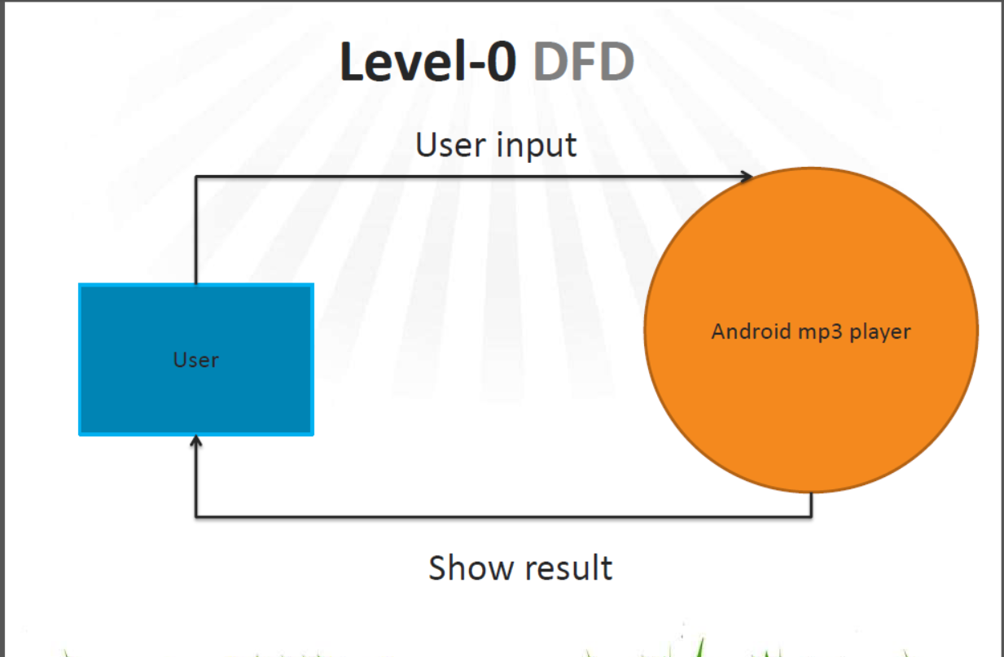

Slide 9
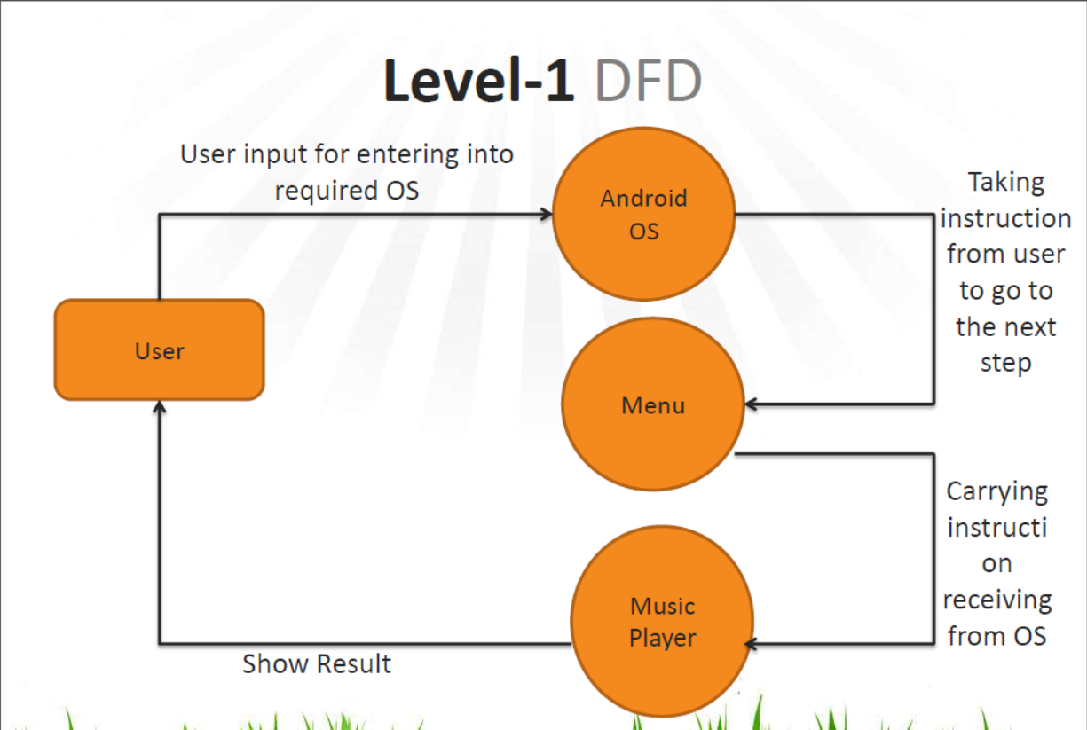

Slide 10
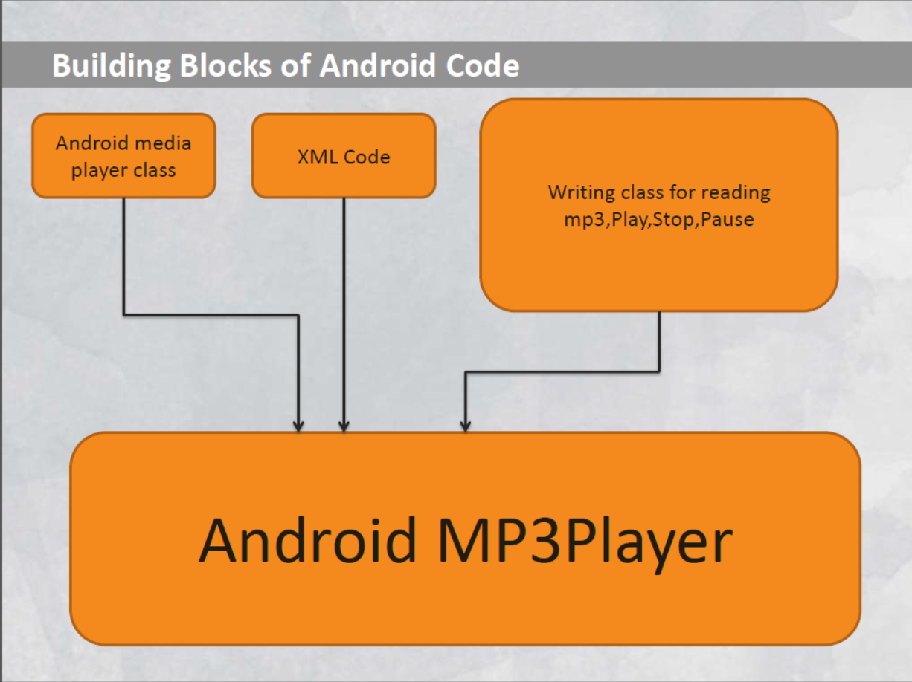

Slide 11
MODULES
ACTIVITIES: Main Activity
ADAPTERS: SongAdapter, ViewPagerAdapter
DATABASE: FavouritesDBHandler, FavouritesOperations
FRAGMENTS: AllSongFragment, CurrentSongFragment, FavSongFragment
MODEL: SongsList

Slide 12
CONCLUSION
Through the development of music player on Android platform, we get a clear understanding of overall process of the system. The core part of the music player is mainly composed of main interface, file browsing and song listing, Grasping the development of the music player has had the preliminary scale small features.

